Slide 1
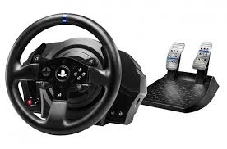
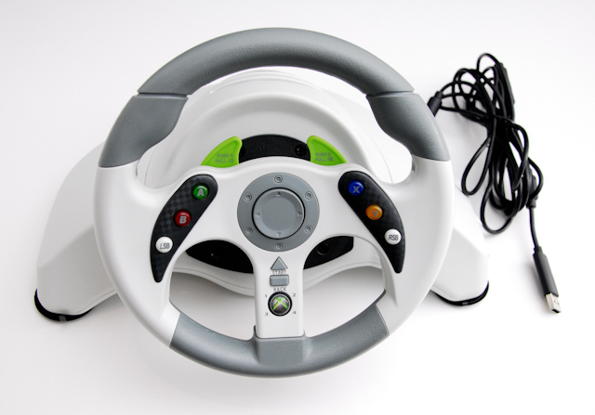
Steering wheel
A gaming steering wheel is used on mainly racing games a gaming steering wheels main output is the vibration it also makes you feel as if you are driving the car makes it feel more realistic the steering wheel is mostly the input device.

Slide 2
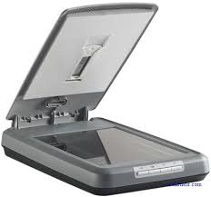
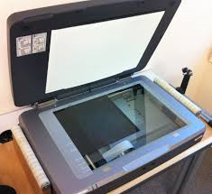
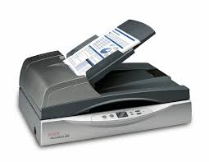
Scanners.
A scanner scans pictures from a page to the computer.
When it saves onto the computer it will save as a image (JPEG or PNG).
If you wrote something it saves time to scan it onto the computer than redo it onto a computer.

Slide 3
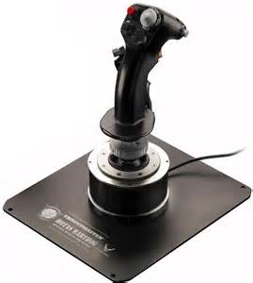
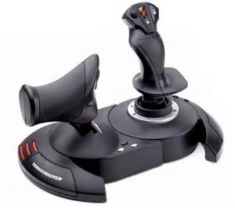
Joystick (Input and output)
A joystick is a input device which is designed to give you a feeling of the reality of flying a plane or anything else that involves a joystick.
A joystick is used to rotate or pivot on a base and reports its angle or direction to the device it is controlling such as a plane. It also feels more realistic.
Joysticks are also used for controlling devices such as cranes, trucks, underwater vehicles, wheelchairs and surveillance cameras.
The advantages of using this compared to a normal controller is that a Joystick has one or more buttons which can also be read by the computer but at the same time do many more jobs than a normal controller.

Slide 4
Microphone
A Microphone is an Input device
A Mic is used for voice recognition, online chatting (Skype, Teamspeak 3) and recording.
Advantages
It allows you to talk on programs such as Skype, TeamSpeak 3 and games with communication built in.
Also allows voice to be recorded for videos…

Slide 5
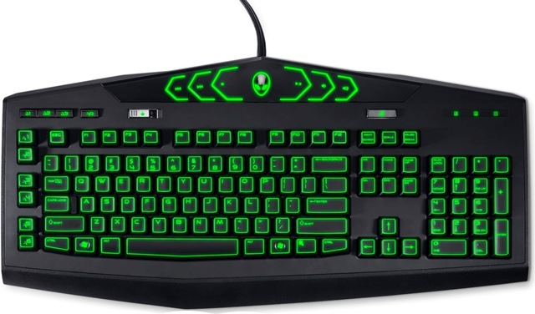
Keyboard
A key board is a input device used to type data into some sort of computer system whether it be a mobile phone, A PC, or another electronic machine. A keyboard usually includes alphabetic, numerical, and common symbols used to type . Keyboards for personal computers are connected to the machine through USB plugs. This can enable people to write text on the computer monitor.

Slide 6
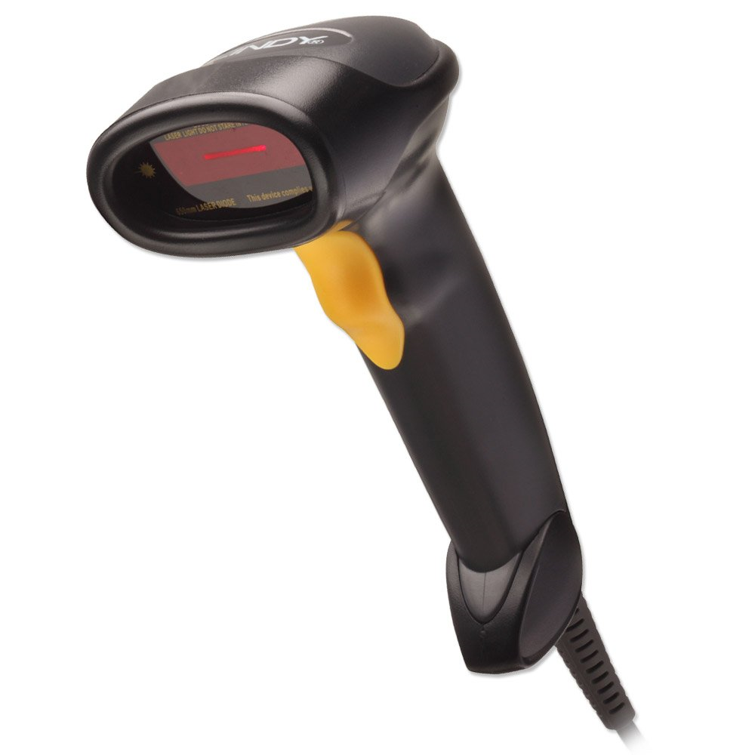
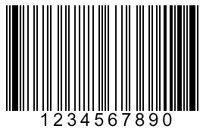
Bar code scanner
A bar code scanner is an input devices that almost all cashiers use. It scans the bar code on products you buy. Each barcode contains a number and the bar code scanner types out that number without any mistakes.

Slide 7
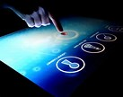
Touchscreen
A touchscreen can be used to do work without using a Mouse.
When a person touches the screen to control whatever is on the screen, it is the Input.
Many touchscreens are found in mobile phones and tablets but are also found in cash machines.
When the screen is showing what is there, it is Output.
The screen contains fine wires that criss-cross or fine light beams, that senses the touch on the screen.
Some of the advantages of using touchscreens is that it is tough, easy to operate and it can be reprogrammed easily.
Touchscreen is an input and output device.

Slide 8
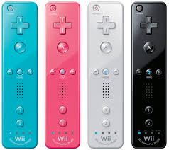
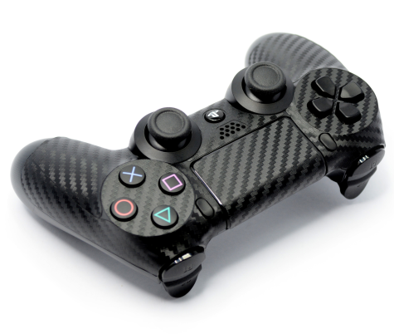
Game controller
A controller, no matter what sort is mainly an input (due to the buttons and joysticks) controller but also an output (due to the vibrations, speaker etc.) controller is a device that is designed to direct and control things in game.
One controller that is an input and output is the Wii controller. It has a motion sensor as well as buttons.

Slide 9
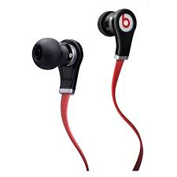
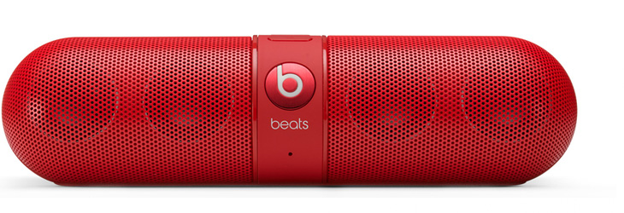
Speakers-headphones
Speakers and headphones are output devices that creates sound!

Slide 10
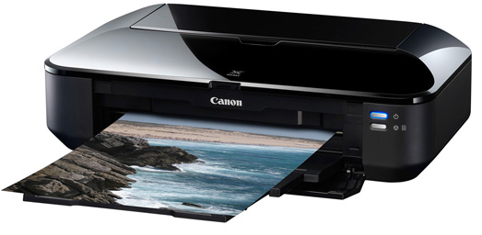
Printers
Printers
Printers
A printer is an output device that takes inputs from the computer. On the computer when you send something to print. The printers CPU then processes your input and then does the correct output required. Printing your photo.
You get different types of
printers for example
laser printer, inkjet printer,
line printer and 3D printer.

Slide 11
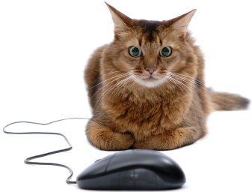
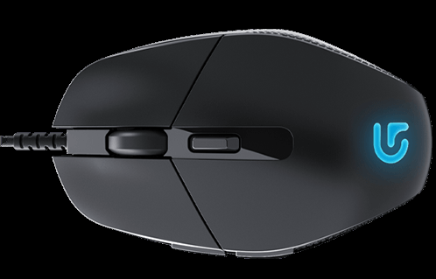
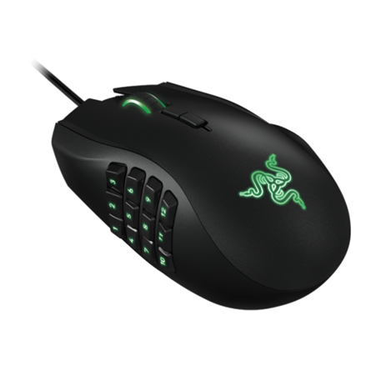
Computer mouse
Computer mice are one of the most basic input devices as you have to move the mouse on a flat surface and then it will use lasers to detect movement and so will move I on the screen. Advantage of using a mouse is that you can get accurate movements into the computer

Slide 12
sensors
Sensors are an input device. And they will be sensing things like temperature. Light sensing. For example on your phone when you take a photo your phone can sense how dark it is. so it knows if you need the flash on/off.
some sensors can test how wet or dry the ground is

